Slide 1
A Crash Course in Topic Modelling with BERTopic
Huw Day JGI Data Scientist

Slide 2
Who are the JGI?
The Jean Golding Institute is the research institute for data science at the University of Bristol.
We have a pool of data scientists who can be costed out to support projects at fractional FTE (usually ~40% for a period of 6 months or more), kind of like a pool of post docs. For more details you can contact me: huw.day@bristol.ac.uk (or Ask-JGI)
All UoB researchers are entitled to up to a day of free support from our Ask-JGI data science helpdesk run by paid PhD students. Just email your query to: ask-jgi@bristol.ac.uk
We also do yearly Seedcorn funding every September, free coding courses and other data science related events.
I’ve been supporting this project for 3 months at 40% FTE as part of a mini competition the JGI ran over the summer.
https://www.bristol.ac.uk/golding/

Slide 3
The Project
Dr Eunice Lo, Dr Jo Godwin and team sent out a survey to Bristol residents to get information about their physical and mental health during heatwaves, cold snaps and storms.
Some of the survey questions had an option for free text, where respondents could articulate how they had adapted to extreme weather. For example: “I would do exercise earlier in the morning when it was cooler” (during a heatwave)
We want to see what sort of themes or topics were mentioned and how frequently. This task is referred to as “topic modelling” in NLP (Natural Language Processing) which is the data science of working with text data.

Slide 4
Why would you want to do topic modelling?
Topic modelling does not replace qualitative analysis.
Qualitative data tells stories, quantitative data puts them in context. Both are useful but for different things!
Given a large amount of free text data, topic modelling gives you a rough summary of the sorts of topics and themes that crop up.
This can then inform a closer look i.e. qualitative analysis.
It’s kind of like exploratory data analysis but for text data.

Slide 5
How might you topic model by hand?
“I closed curtains and drank more water”
“I stayed hydrated. Took the dog out earlier”
“Routine changed, went for walks before it got hot”
“Quite enjoyed it! Used more suncream tho”
“See previous answer”
“Cooked less warm food, ate more ice cream”
Notes:
Start reading documents and noting down characteristics.
When you read enough, you’ll start seeing patterns pop out – this might lead you to double back on yourself when you notice a pattern later on.
You might also want start to discount themes as “topics” if they appear *too* frequently or to start collecting info about how important certain terms are (i.e. their weighting).
You could make a list beforehand of potential topics and try and match your documents to this list, but this might lead you to miss other topics.
The longer the list of your documents, the longer it takes and the more diverse topics, the harder it is to do well (this is true when we use automatic methods too!)

Slide 6
How can you do topic modelling automatically?
Previously Latent Dirichlet Allocation (LDA) was used; here’s a nice YouTube playlist on using LDA in Python for Topic Modelling: https://www.youtube.com/watch?v=N0crN8YnF8Y&list=PL2VXyKi-KpYttggRATQVmgFcQst3z6OlX
Currently the standard is BERTopic Modelling. This is the method we used for this work. All the code for this has been done in Python: https://github.com/JGIBristol/ClimateTopicModelling
You can do some other Topic Modelling techniques in R too; here’s an example of someone doing Topic Modelling in R for how Taylor Swift’s song lyrics have changed over time: https://www.youtube.com/watch?v=rXDv0ZuX0Fc
Notes:
The main method for a while was Latent Dirichlet Allocation (LDA) which uses Bayesian methods to do topic modelling. You basically try and get a system to generate a synthetic document of certain topics and see how well it matches your originals. Currently the standard is BERTopic Modelling which relies on some LLM embedding of text into vectors and then you basically just end up with a high dimensional unsupervised clustering problem but you also want to use the text to label your clusters after the fact.

Slide 7
When can you do topic modelling automatically?
More data/documents is (usually) better.
Diversity of topics is a limiting factor, so the more topics you expect, the more documents you should have.
Shorter “sentences” are easier to interpret.
The less standard the sentences are (e.g. slang or variety of languages) the more documents you should have.
A JGI Seedcorn Project that used both LDA and BERTopic Topic Modelling on a collection of 424,629 Tweets from Medical Influencers talking about COVID-19: https://jeangoldinginstitute.blogs.bristol.ac.uk/2024/10/02/exploring-the-impact-of-medical-influencers-on-health-discourse-through-socio-semantic-network-analysis/
Notes:
A longer writeup of their work in a publication: https://arxiv.org/pdf/2407.05198

Slide 8
How does BERTopic work?
Embed documents
Dimensionality reduction
Cluster documents
Bag-of-words
Topic representation
(Optional) Fine-tune Topic representation
https://maartengr.github.io/BERTopic/algorithm/algorithm.html

Slide 9
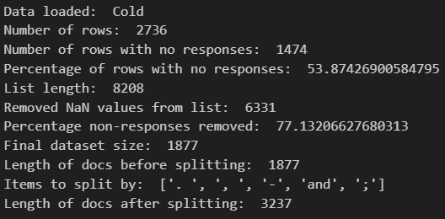
0. Pre-processing
Remove empty entries and flatten into a list.
Split longer documents according to various “splitters”
E.g. full stops, other punctuation, conjunction words like “and”
Reindex to keep track of who said what.
Notes:
Before we do any topic modelling, we need to pre-process our data from an excel spreadsheet with missing values into a list.
We also want to remove any documents (i.e. survey responses) that we don’t want to contribute to our analysis.
There are methods of removing topics retrospectively, but I’ve found it’s easier to run the model, spot what sort of documents you want to remove and then remove these from your documents (either manually or with some other NLP tools) before training the model again.
In this case, the main types of responses we wanted to remove were those where people had said things like “see previous question” and “no comment”.
This will be very contextual based on what you’re looking for in your analysis.

Slide 10
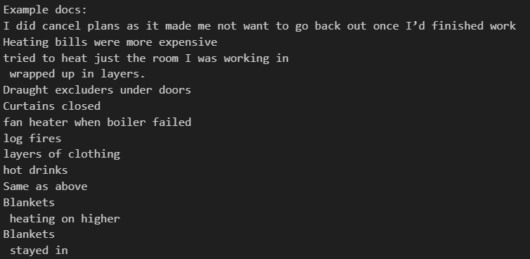

Slide 11
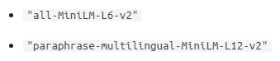
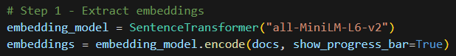
1. Embed documents
We start by converting our documents to numerical representations.
There are lots of methods for doing this, but the default for BERTopic is sentence-transformers.
Highly recommend 3Blue1Brown’s series on neural networks and specifically Chapter 5’s visual intro to embeddings: https://youtu.be/wjZofJX0v4M?si=iae0rolfQDhvI-1l&t=747
In practice we embed sentences, not just words, because we want each individual document to be represented as a whole.
Directions in the embedding vector space have associations with certain meanings extracted from training data*
*which means some encoded biases might be present
Notes:
Example of Bias from Language Models: Doctors can't get pregnant and other gender biases in ChatGPT https://hkotek.com/blog/gender-bias-in-chatgpt/

Slide 12
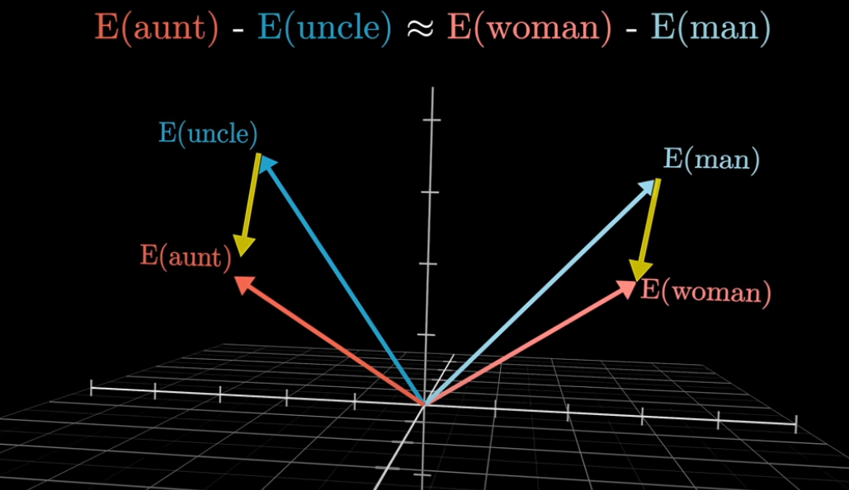
https://youtu.be/wjZofJX0v4M?si=iae0rolfQDhvI-1l

Slide 13
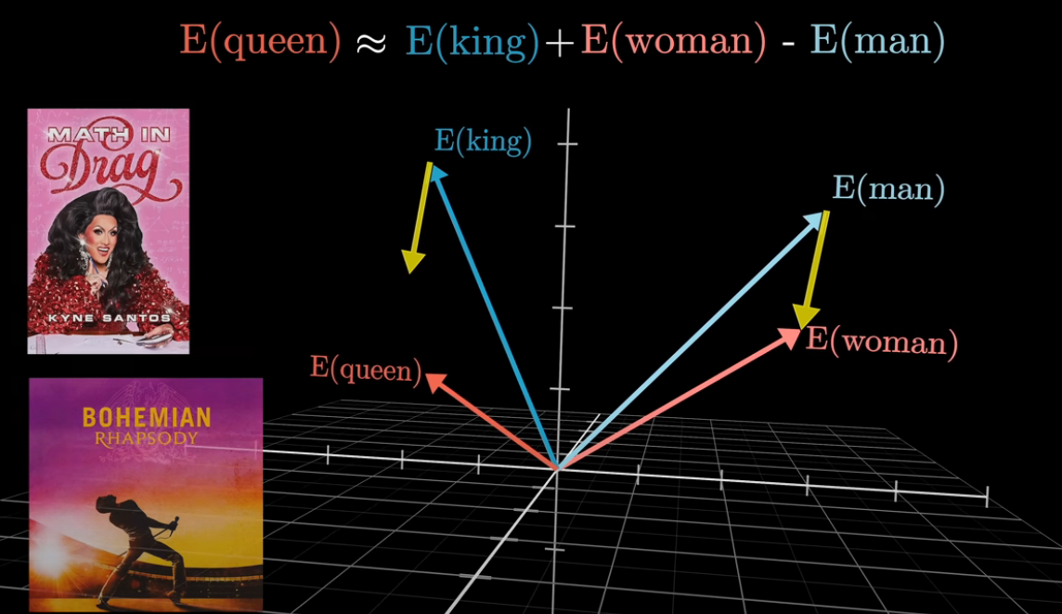
https://youtu.be/wjZofJX0v4M?si=iae0rolfQDhvI-1l

Slide 14
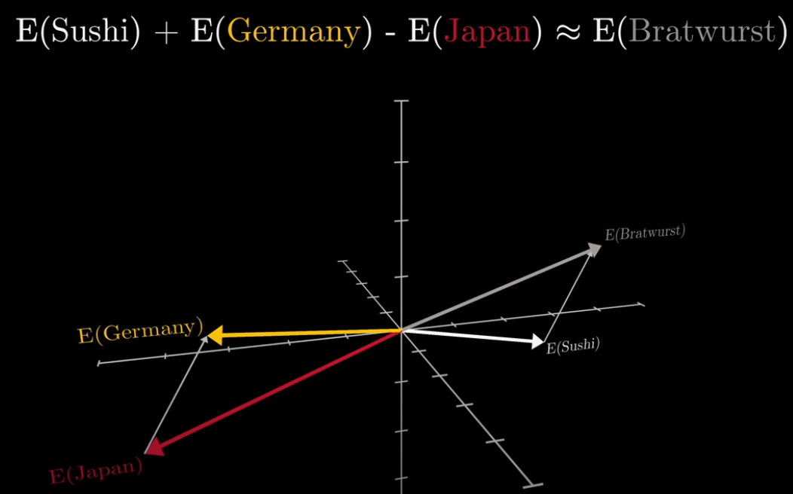
https://youtu.be/wjZofJX0v4M?si=iae0rolfQDhvI-1l

Slide 15
2. Dimensionality reduction
We want to cluster our vectorized documents, but we’re currently in quite a high dimension space; GPT3’s embedding space is 12,288 dimensions but our default embedder is 384 dimensions.
Before we do clustering, it’s recommended we do dimensionality reduction. You can actually skip this step entirely, but this is not recommended! It’s all to do with the “curse of dimensionality”.
BERTopic can use lots of different methods for dimensionality reduction but the default is UMAP which is a technique that can keep some of a dataset’s local and global structure when reducing dimensionality.
Counterintuitive Properties of High Dimensional Space: https://people.eecs.berkeley.edu/~jrs/highd/
Notes:
High dimensional vector spaces behave quite counterintuitively and we need to be careful how we apply machine learning tools to datasets in these spaces.
StatQuest has some great videos explaining UMAP: https://www.youtube.com/watch?v=eN0wFzBA4Sc

Slide 16
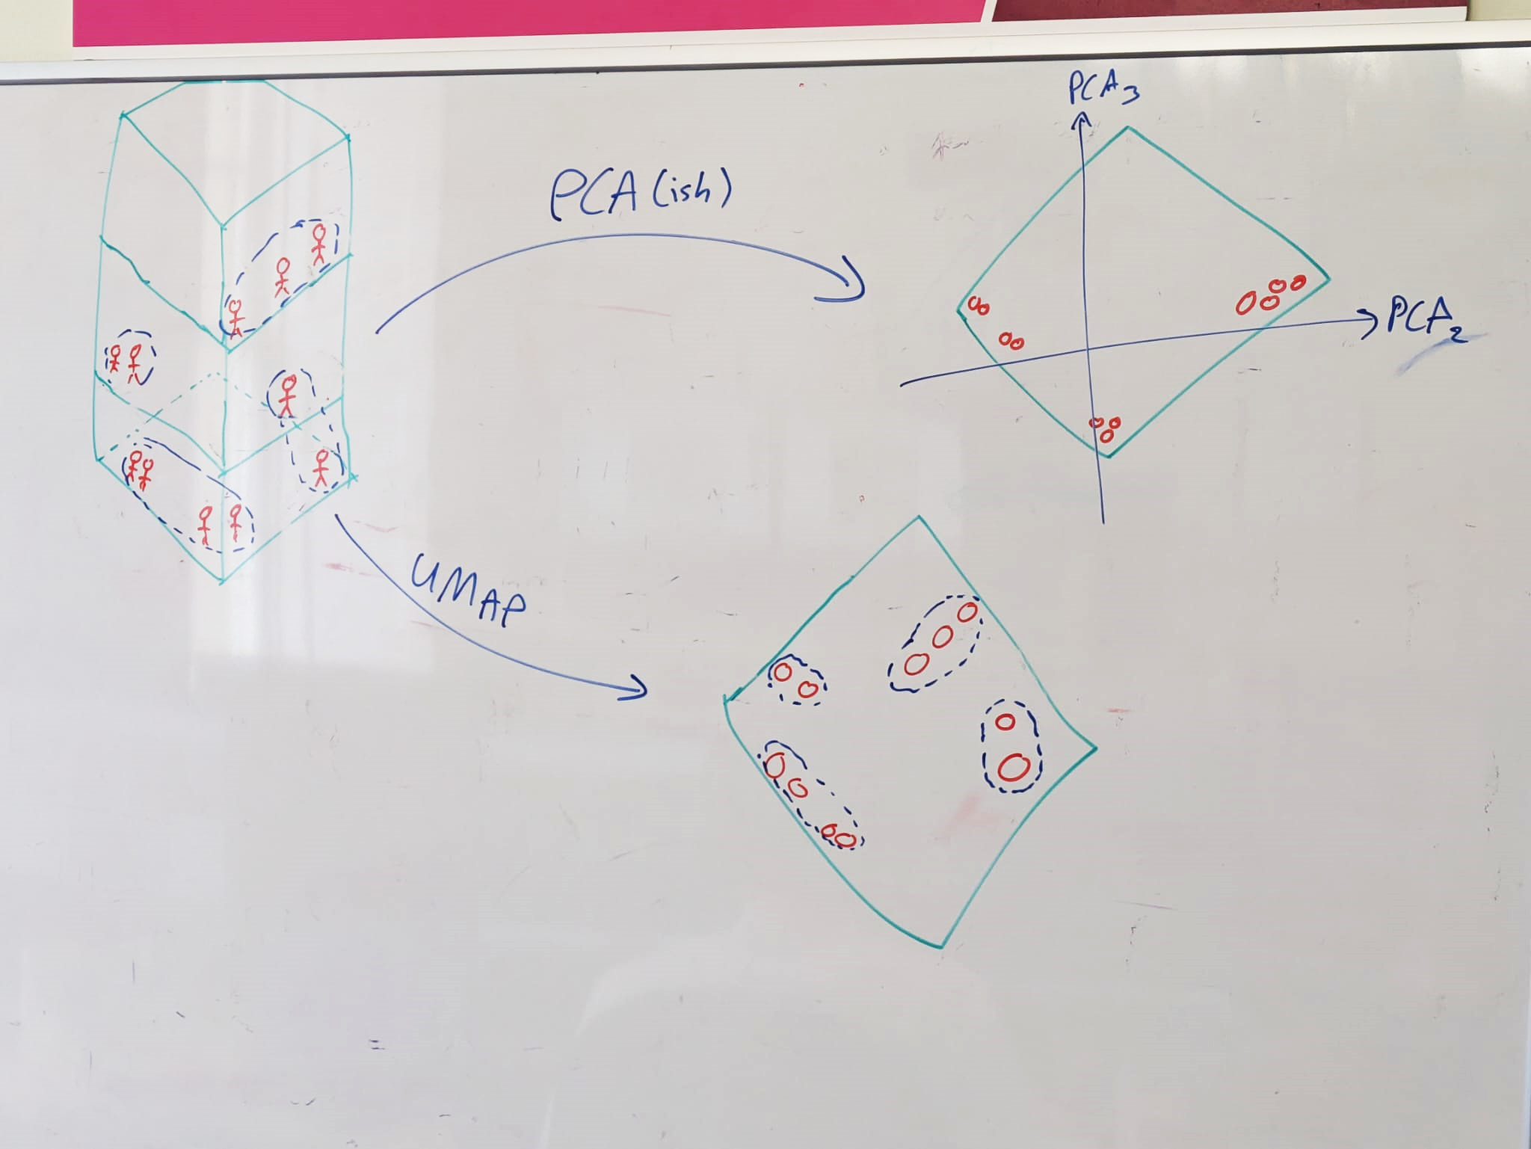
Hour long video on the difference between UMAP and PCA:
https://www.youtube.com/watch?v=P07xnm2TOhY
Notes:
Imagine a situation where you have a bunch of people in a 3 storey office building (on the left). Directions in the 3 dimensional building have meanings: More senior employees have offices on higher floors. The sun comes in from the right handside of the image, and data scientists don’t like the sun so if someone is on the left of the building they’re more likely to be a data scientist and if they’re on the right then they’re more likely to be admin/management.
We want to compress our view of this building into a way where directions have some meaning.
If we just naively looked from the top of the building (top right) and looked at where people were, we do capture the sense of if they’re close to the sun (so we get the data science/admin split) but we completely lose any information about seniority. When we do dimensionality reduction using a tool like UMAP (bottom right), we deduce clusters in the data first and then we project to a lower dimension, we try and preserve the clusters and the distances between the clusters. The bottom right shows a situation where we’ve compressed to 2 dimensions but higher up on the plot corresponds to seniority and left and right still shows the data science/admin split. I did it by hand, so it’s obviously not perfect, but hopefully that makes some intuitive sense!

Slide 17
Uniform Manifold Approximation and Projection (UMAP)
Using UMAP dimension reduction to boost the performance of density based clustering is a bit subtle, recommend reading more here: https://umap-learn.readthedocs.io/en/latest/clustering.html#umap-enhanced-clustering
When we use UMAP to enhance dimensionality reduction, we dictate how big we expect the clusters to be with the parameter “n_neighbors”. We want our output from this to be quite dense, we set this number to be large so we end up with more points packed together.
Notes:
You don’t have to use UMAP. BERT is very modular so you can pick your favourite clustering method and use it here instead. UMAP is the default and the recommended, but you could use Principal Component Analysis or whatever you like. The parameter in the BERT Topic model is called “umap_model” though which can be a bit confusing, so worth commenting well!

Slide 18
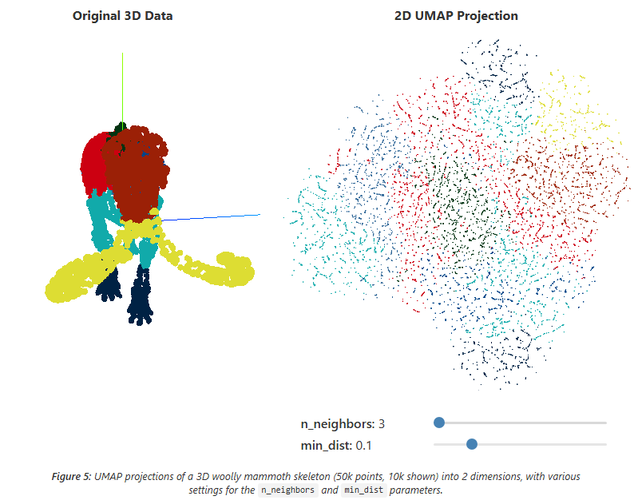
https://pair-code.github.io/understanding-umap/

Slide 19
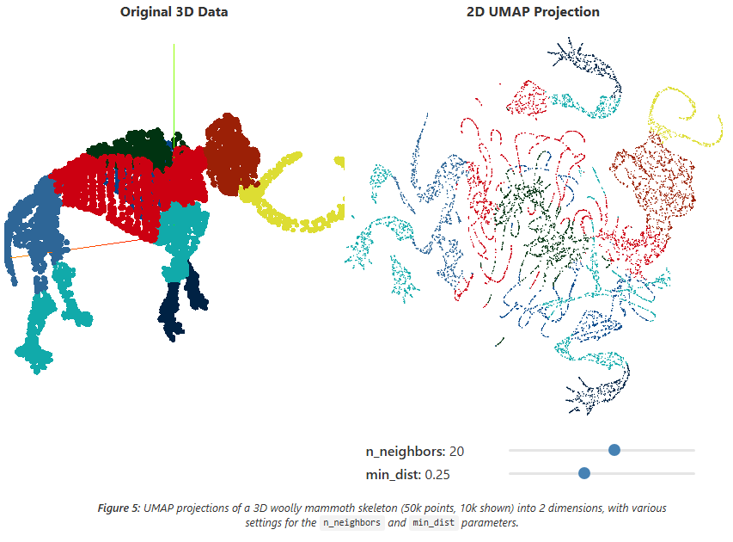
https://pair-code.github.io/understanding-umap/

Slide 20
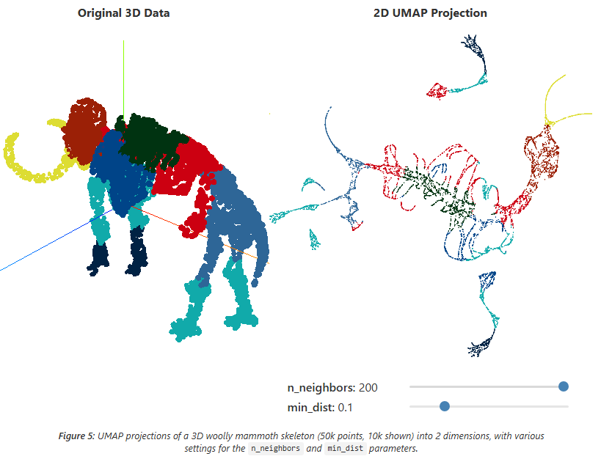
https://pair-code.github.io/understanding-umap/

Slide 21
3. Cluster documents
Now we want to sort our documents into clusters. BERTopic works with lots of different clustering methods, but by default it uses HDBSCAN (Hierarchical Density-Based Spatial Clustering of Applications with Noise).
Nice blog on K-means clustering vs HDBSCAN: https://pberba.github.io/stats/2020/01/17/hdbscan/
K-Means Clustering works better: | HDBSCAN works better:
“Round”/spherical clusters | Clusters are arbitrary shapes
Equally sized/dense clusters | Clusters of different densities and sizes
No noise/outlier points | Some noise and maybe some outliers
You know how many clusters there are | You don’t know how many clusters there are
Notes:
StatQuest has a great video for an intuition as to how DBSCAN (the related predecessor) works: https://www.youtube.com/watch?v=RDZUdRSDOok&t=0s Again, since BERT is modular, you can sub in your preferred clustering method here. HDBSCAN is the default because it uses density based clustering, which is handy in higher dimensions. HDBSCAN can find clusters of different shapes and has the nice feature of identifying outliers where possible. This is handy because some documents might be unrelated to the rest.
HDBSCAN has the features that 1) you can’t tell it directly how many clusters you expect and 2) it will not force all points to be in a cluster and will output a list of outlier points. If you don’t want this, you might consider using something like K-Means clustering which has the downside of being more centroid based in how it works (stats quest has a great video on this one too!) but you can tell if how many clusters you expect directly and it will force points to be in clusters.
BERT also has methods where you can use hdbscan but tell it to reduce to a set number of clusters as well as ask it to reduce outliers. These methods are a bit more implicit and can be a bit harder to interpret and justify.

Slide 22
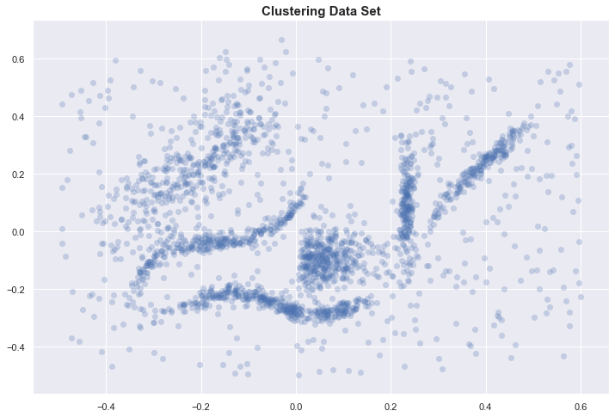
https://pberba.github.io/stats/2020/01/17/hdbscan/

Slide 23
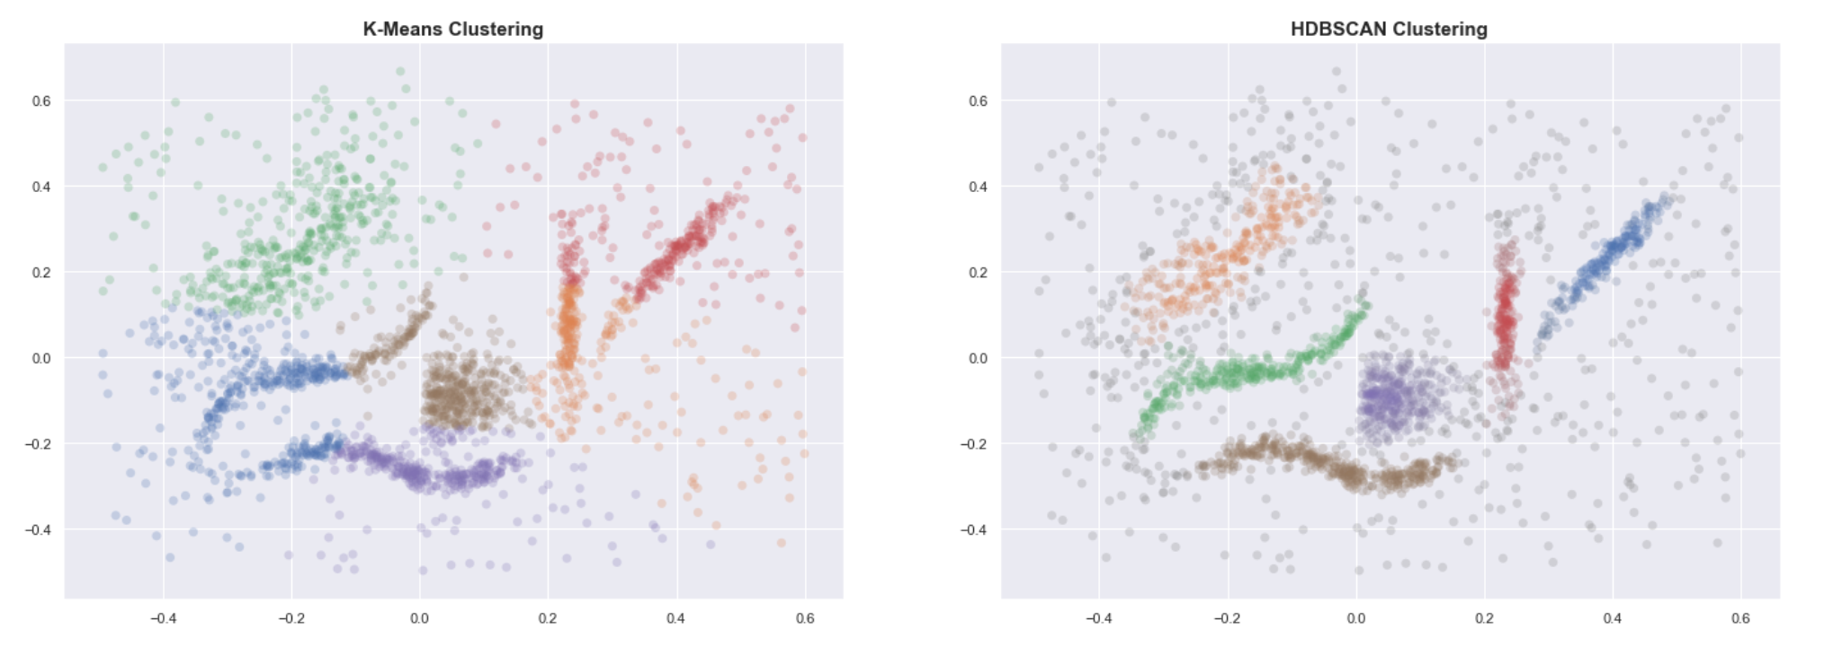
Even when provided with the correct number of clusters, K-means clearly fails to group the data into useful clusters. HDBSCAN, on the other hand, gives us the expected clustering.
https://pberba.github.io/stats/2020/01/17/hdbscan/

Slide 24
Hyperparameter tuning
We can use the parameter “min_cluster_size” to indirectly influence how many clusters you have. Note this parameter needs to be tuned for different datasets (and their sizes) for optimal performance!

Slide 25
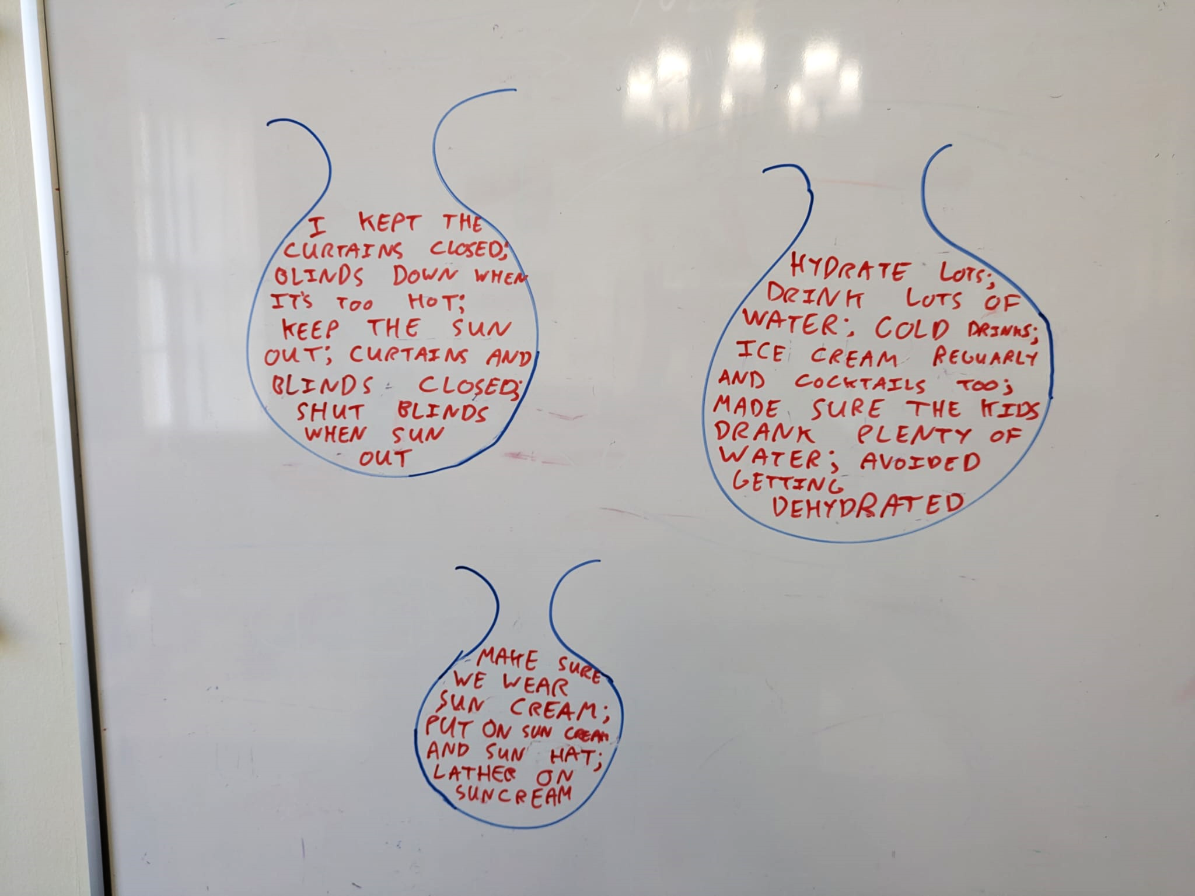
4. Bag-of-words (Tokenizing Topics)
We want to find a way of representing each cluster to give an idea of the sort of documents that appear in them.
We take all the documents in each cluster and combine them into a single document and then count how many each times each word appears in each cluster.
This generates something called a “bag-of-words” representation for each cluster.
Notes:
This step also allows for processing the documents however you want without affecting the first step where we embedded the documents.
The two steps I found most useful were removing stop words and accounting for n-grams.

Slide 26
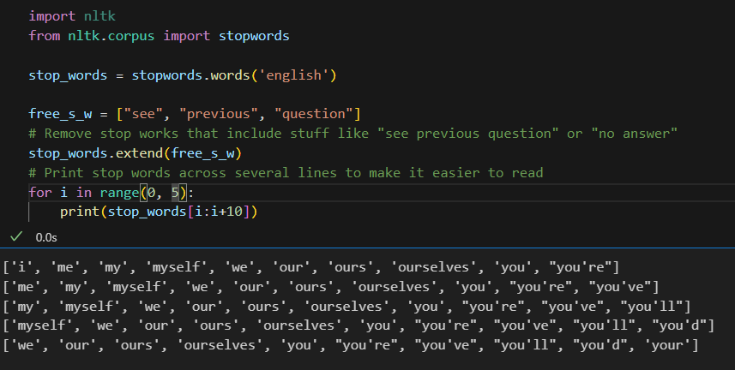
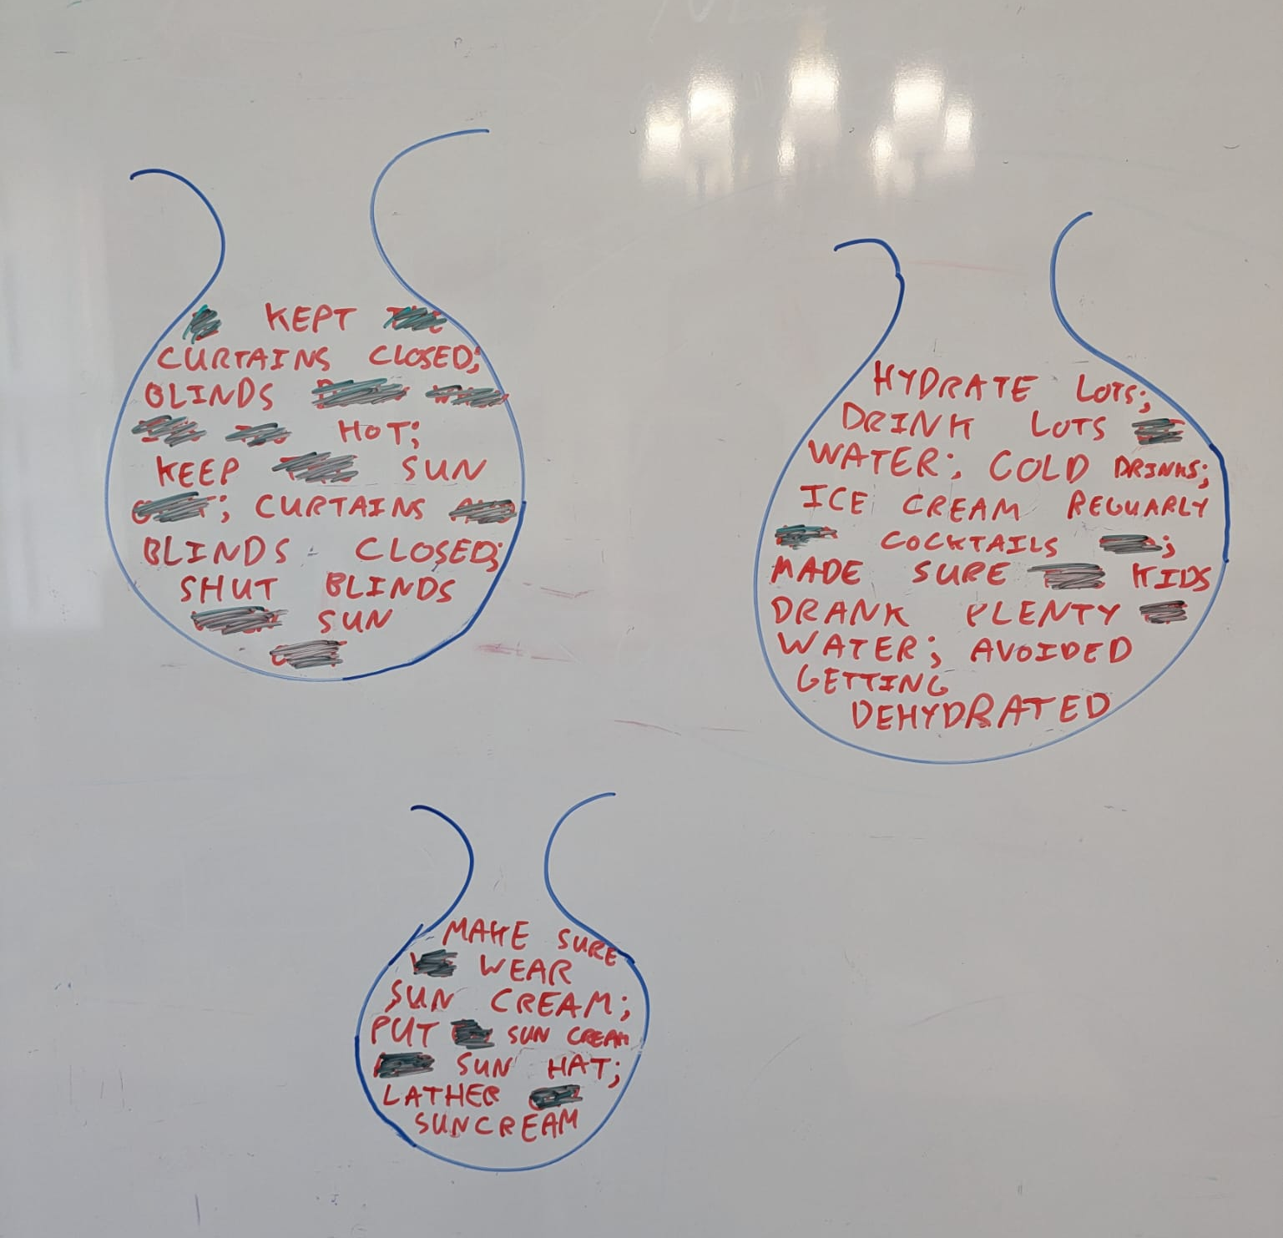
Stopwords
Notes:
Stopwords are a great tool in NLP but there’s a subtlety in how they’re used in BERTopic. If we remove certain stop words from our bag-of-words representation, we do not remove the documents from our topic model. What you can end up with is a cluster of documents that follow a certain topic (e.g. “see previous question” type responses) where you’ve removed all viable representations – but you have not removed these documents!
If you see a topic of documents you don’t want, you need to remove these documents as part of your pre-processing. Removing stop words for your tokenizing of topics is only useful if you have documents that you *do* want represented but you want to control how they’re represented. E.g. you might have a topic where lots of people talked about “keeping themselves cool” and the representation you want is “keeping cool” and not anything like “themselves”

Slide 27
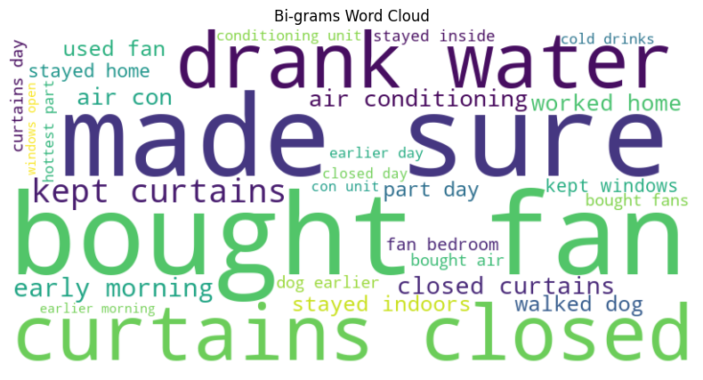
N-grams (N=1, 2 and 3…usually)
Notes:
N-grams are basically common sequences of “N” words. It can be quite useful to include these amongst your representations and other sorts of processing. You can dictate what sort of n-grams you want, 1-grams are just words, 2-grams are common pairs, 3-grams are common triplets etc. but the standard is usually including grams of length 1, 2 and 3. This might be different depending on your training data.

Slide 28
Under the hood
The “stop_words” parameter is just your list of stop words (custom or from NLTK).
“min_df” tells you how frequent a word must be before being added to our potential representation. You can imagine that if we have a million documents and a certain word only appears a single time across all of them, then it would be highly unlikely to be representative of a topic.
“ngram_range” tells you what lengths of n-grams you want, in this case we want 1-grams, bi-grams and tri-grams.

Slide 29
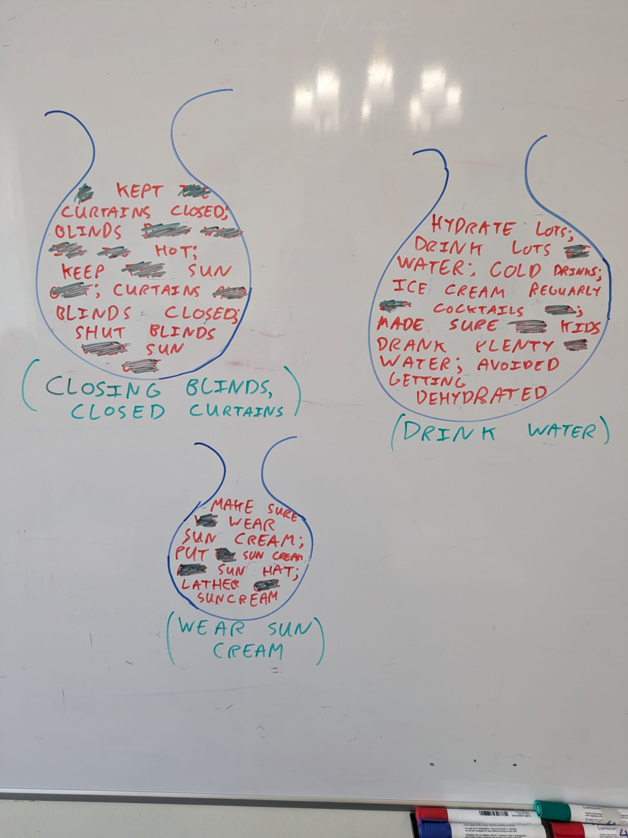
How do we turn this into meaningful and useful representations?
Some example representations are drawn under each bag.
What representations would you use?
How would you systematically pick out good representations?

Slide 30
A word* is a good candidate representation for a given topic if:
*could be a single word or n-grams
If it appears in that topic lots.
If it doesn’t appear in the other topics very often.
Maybe also want to control for how many words there are per topic (i.e. if topics are smaller, we’d expect a lower number of good representations on average)

Slide 31
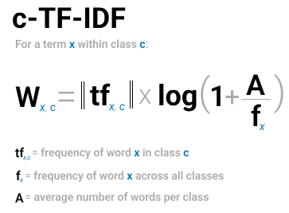
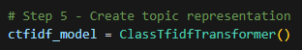
5. Topic representation
Term Frequency – Inverse Document Frequency (TF-IDF) is a method you can apply on a set of documents where you compare the importance of words between documents.
If we treat all documents in a cluster as a single document and then apply TF-IDF then we would get importance scores for words within a cluster.
This is called class based TD-IDF or c-TF-IDF. The most important words per cluster are essentially descriptions of the topics!
Notes:
There are two parameters worth exploring in the ClassTfidfTransformer, namely bm25_weighting and reduce_frequent_words. (We didn’t use either for this model)
At smaller datasets, bm25_weighting=True variant can be more robust to stop words that appear in your data.
Some words appear quite often in every topic but are generally not considered stop words as found in the CountVectorizer(stop_words="english") list. To further reduce these frequent words, we can use reduce_frequent_words to take the square root of the term frequency after applying the weighting scheme. https://maartengr.github.io/BERTopic/getting_started/ctfidf/ctfidf.html

Slide 32
6. (Optional) Fine-tune Topic representation
c-TF-IDF is a method that we can use to quickly generate accurate topic representations.
We can optionally try and improve on this with a variety of methods.
We can consider the c-TF-IDF generated topics to be candidate topics. They each contain a set of keywords and representative documents that we can use to further fine-tune the topic representations.
Notes:
This step is optional because often the representations generated by step 5 are sufficient! Having a set of representative documents for each topic is huge advantage as it allows for fine-tuning on a reduced number of documents. This reduces computation for large models as they only need to operate on that small set of representative documents for each topic.

Slide 33
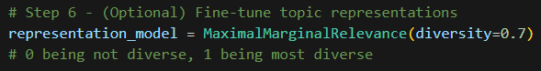
Maximal Marginal Relevance (MMR)
It is important that our topic representations are suitably diverse: “using fans”, “used fan”, “use fans” are semantically identical but give us the same insight on a topic.
To decrease this redundancy and improve the diversity of keywords, we can use a representation model called Maximal Marginal Relevance (MMR).
MMR considers the similarity of keywords/keyphrases with the document, along with the similarity of already selected keywords and keyphrases. This results in a selection of keywords that maximize diversity with respect to the document.
You can tune how diverse these representations are with the diversity parameter; 0 being not diverse, 1 being most diverse.
Notes:
There are lots of other representative models available and you can also chain models together, calling on things like MMR and also exploiting APIs with LLMs like ChatGPT and get to describe your topic for you!

Slide 34
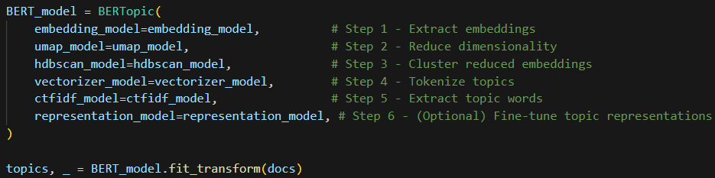
Putting it all together
Notes:
You can literally load the model with model = BERTopic() and call it a day, but the way I’ve written this code makes it easier to change the parameters under the hood! Most of the visualizations are useful for model diagnostics but less so (in my opinion) for sharing results so in the next few slides I’ll show some example outputs.

Slide 35
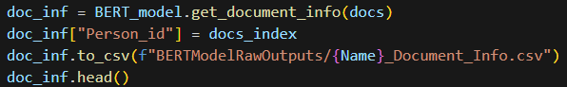
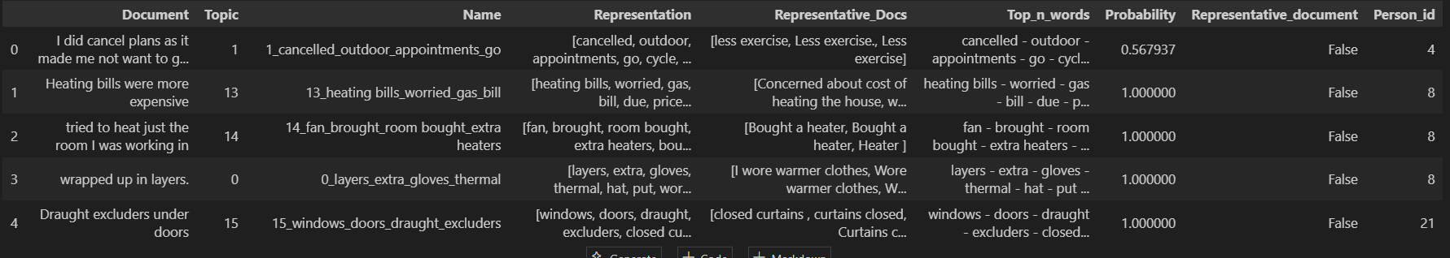
Document Info
Notes:
For every document we loaded in, it is assigned to a topic. Each topic has a number, name, representation etc. associated with it. The final column “Person_id” is some code that helps keep track of how much stuff was said by each individual (this will make more sense in a few slides!

Slide 36
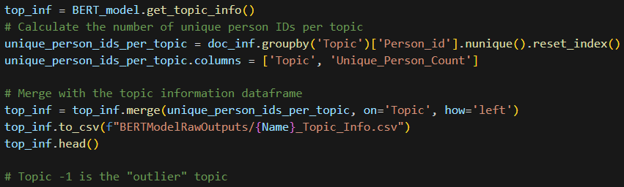
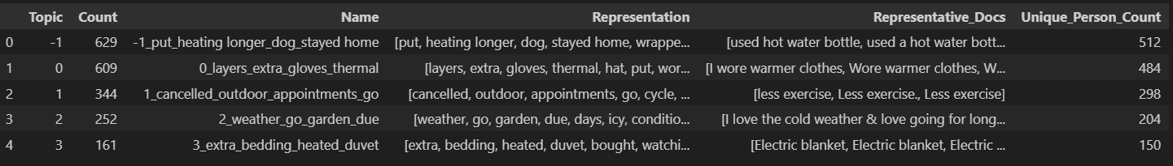
Topic Info
Notes:
Similarly, for each topic, we can get a summary of it. Note the distinction between “Count” and “Unique_Person_Count”. This is a function of how we pre-processed and “split” our documents. If you didn’t split any of your documents, these numbers would be the same.

Slide 37
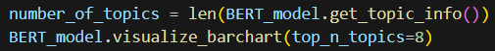
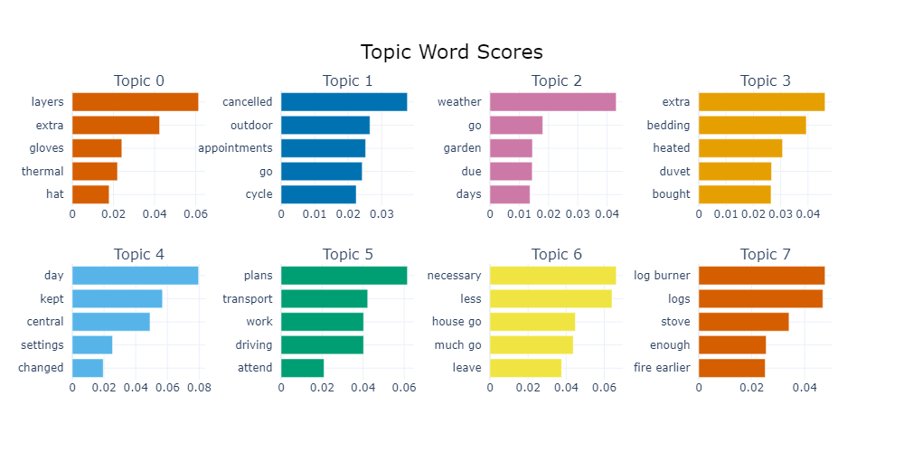

Slide 38
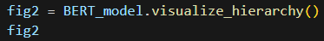
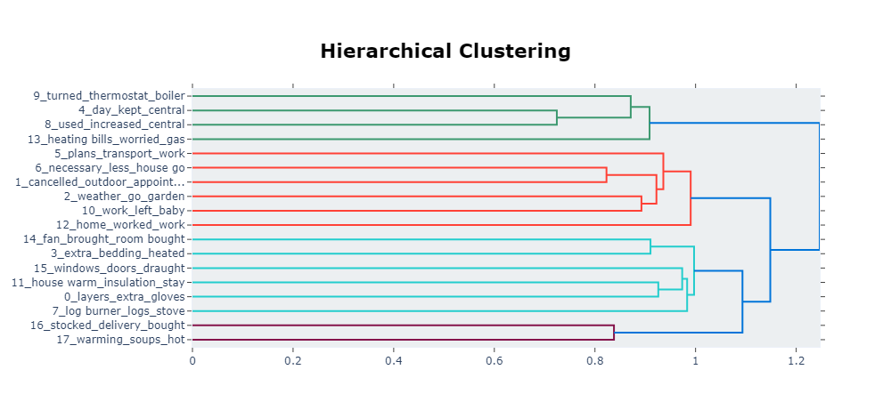
Notes:
I’ve found that diagnostically, the most useful plots are the hierarchical clustering and the get topic words from the previous slide. They give you a sense of how close topics are to one another and what topics are about.

Slide 39
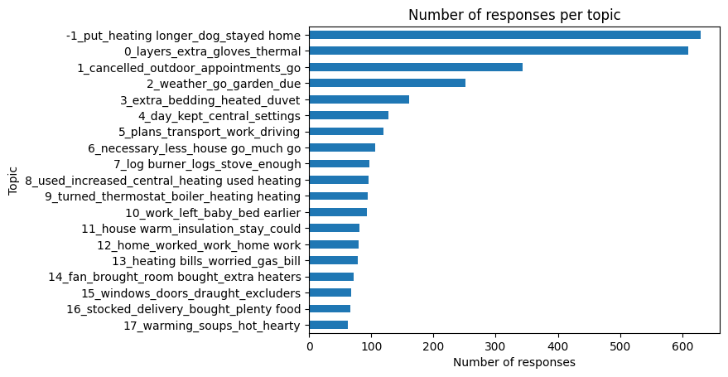
Number of responses per topic

Slide 40
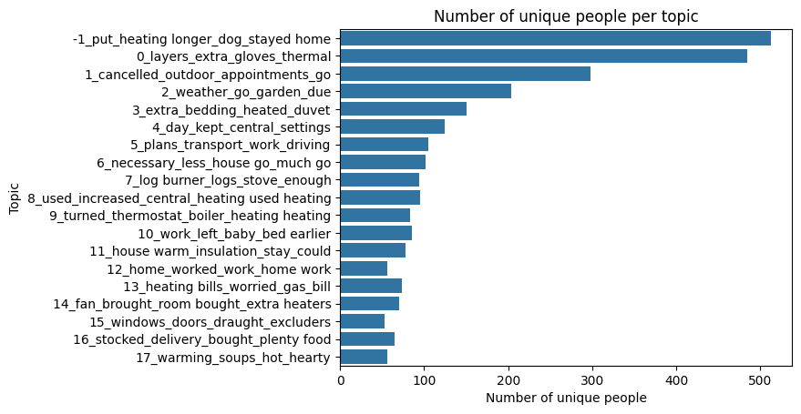
Number of unique people per topic

Slide 41
Fine-tuning
As with all ML models, we have to do some fine tuning to improve our model.
You run your model, visualize the outputs and then tweak parameters and run again.
BERTopic does allow you to reduce the number of clusters or number of outliers after the model is trained, but this makes things a little bit less reproducible.
We chose to finetune parameters to make the noise cluster smaller and then manually reassign (where appropriate) some of the outliers.

Slide 42
Other cool things you can do with BERTopic (not a comprehensive list)
Dynamic Topic Modelling: if your documents have a temporal element (e.g. publication date of paper titles or tweets) then you can map how topic representations change over time.
Zero-shot Topic Modelling: if you have some idea of what topics might appear in your data you can it a suggestion list and fine tune how much you want your topic model to pay attention to this.
BERTopic is quite a new tool and so is constantly being updated, zero-shot was released early September 2024!
The downside is that the “best practices” and standards of validation are still sort of developing in this area.
Thanks for listening ☺
Notes:
Note with Dynamic Topic Modelling, the clusters themselves won’t change over time, but their representation might. So what happens is you do topic modelling on all your documents regardless of time component and then you explore, given on the produces topics, how the representation varies over time.
Zero-shot ML problems are those where no labelled examples are given. An example might be if you trained a model to recognize images of horses with labelled data and then gave it enough info to deduce that zebras look like horses with black and white stripes. We considered using zeroshot for our analysis (and so there is some commented out code that can be directly integrated with the topic model) but decided that it felt like putting our assumptions on peoples’ lived experiences and so it would be more appropriate to just let the topic model run unsupervised and see what pops up.

Slide 43
The slide with the useful links:
Public GitHub Repo with my Python code and this PowerPoint (but no data): https://github.com/JGIBristol/ClimateTopicModelling
JGI Website: https://www.bristol.ac.uk/golding/
Data Science and Research Software Engineering Training: https://bristol-training.github.io/
My email: huw.day@bristol.ac.uk
Ask-JGI helpdesk email: ask-jgi@bristol.ac.uk

